Slide 1
Predicting US OIL rig ACTIVITY
Bryan Spencer
https://github.com/brspencer90

Slide 2




Why oil and gas?
The oil and gas industry supplied 8% of US GDP ($1.7T)
Petroleum extraction and associated industries employed 10.3 million in 2018.
Many of things associated with petroleum products play a significant part in everyday life.
Notes:
I know you’re scratching your head right now thinking, “but the Green New Deal!”, “What about solar and wind?”, “Why are we even talking about oil and gas right now?”. I understand your concerns, the way forward is with renewable energy, and transitions take time. Even in the future the current oil and gas industry will be very important in the future make up of energy. Here’s a few facts about the oil and gas industry in the US. The oil and gas industry added 8% of the overall US GDP in 2018. That’s $1.7T.
The oil and gas industry employed 10.3 million people in 2018. The upstream industry (those directly involved in extracting the oil) employed about 1.5 million. These jobs are typically high paying and feed a lot of capital back into the local economies.
In addition, as mentioned before, the oil and gas industry will not go away anytime soon. A lot of oil and gas products are used in household appliances such as gas stoves, and water heaters. Currently transportation is heavily reliant on oil and gasoline. In addition, any plastic products are derived from petroleum.

Slide 3

WHAT’S The problem with oil and gas?
COVID-19 has significantly affected the oil and gas industry
Reduced mobility worldwide has evaporated demand
Oil prices have crashed 40%
Upstream industry lost 110K jobs
Will the industry recover?
When will activity rebound?
Notes:
So why is the oil and gas industry important now? COVID-19 has turned the industry on its head, specifically in the US. The growth of the oil and gas industry in the US has been fuelled by investment and debt to finance current activities. With the reduced mobility worldwide due to COVID-19, demand has plummeted and oil prices have crashed 40%. In just the upstream industry, 110,000 jobs have been lost since April. With an apparent subsequent wave in cases worldwide, will this demand recover? Will the industry respond as a whole to increased demand? When will the activity rebound?

Slide 4
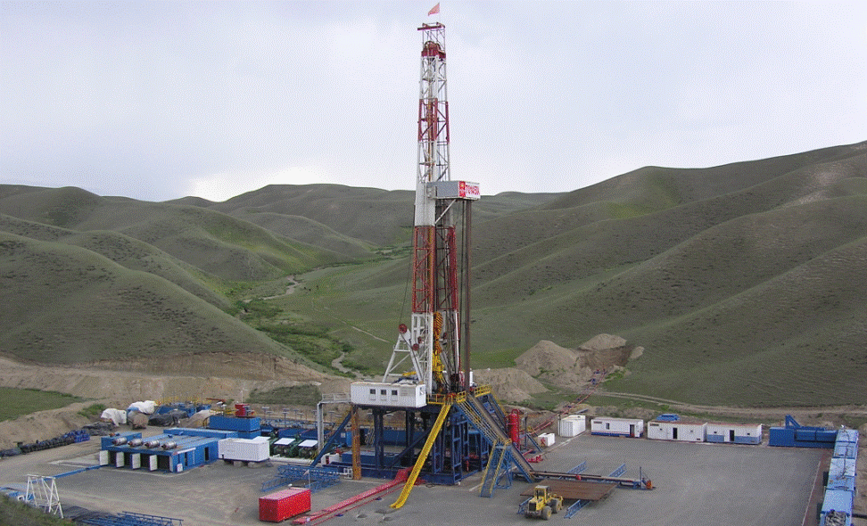
WHY PREDICT OIL RIGS?
What is a rig?
Each rig involves about 100 jobs
Used as a measurement of expected industry activity
Important indicator, but only a portion of total industry activity
Notes:
What is a rig? Starts the process for extracting oil from reservoirs deep under surface
A rig directly involves dozens of workers, and indirectly involves many more – from truck drivers, to repair technicians, to contractors. A good measure of thumb is that each rig involves about 100 jobs.
Oil rig count is a good measurement of expected industry activity, though do not expect the jobs / rig to reflect the entire industry, as there are many different services offered, and drilling is just a portion of the entire upstream industry

Slide 5






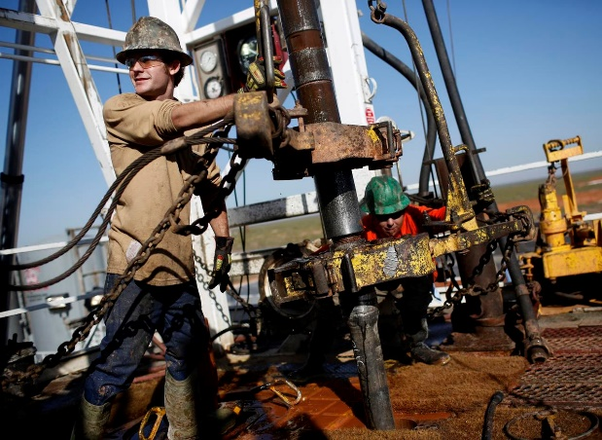
Who might benefit from this?
Notes:
So who would be interested in having a better idea about rig count?
As a former oil and gas employee, it’s a question that I had and got me to investigate this problem. Thousands of laid off or furloughed employees are asking the same question. Will I ever be able to come back to this industry?
With so many people out of work, there are a lot of oil and gas employees with a lot of talent sitting idle. If activity were to pick up, major companies such as Shell, ExxonMobil, or service providers such as Schlumberger would want to make sure they respond appropriately with sufficient man-power, equipment, and other assets. If they make a decision too late, a lot of good talent might disappear, or prices would increase.
In addition, as mentioned investors play a large role in this as well. They could use this data to appropriately assess risk and make better choices on investments in the near future.

Slide 6
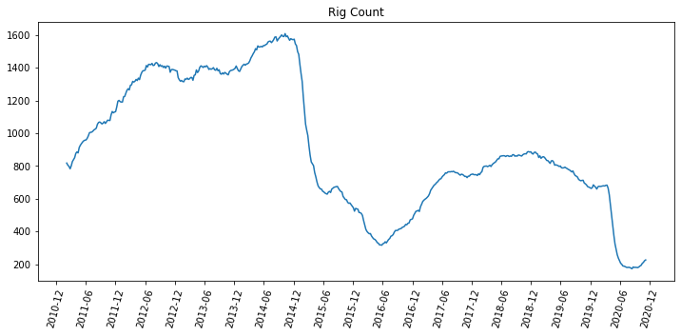
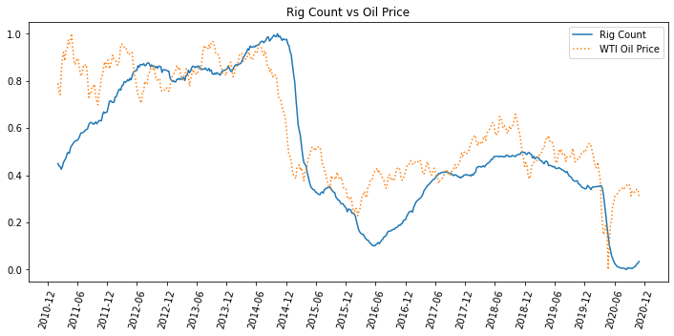
WHERE ARE WE AT TODAY?
Notes:
So where are we at today?
Here is a graph showing the current US rig count in blue. As you can see there have been two instances of “crashes” where rig count has dropped significantly. Why did this happen?
Most of this can be explained by looking at the oil price. As you can see the rig count is closely correlated to the oil price. However, if you look near the end of the graph you can see that oil prices have quickly recovered, however the rig count has not recovered.

Slide 7
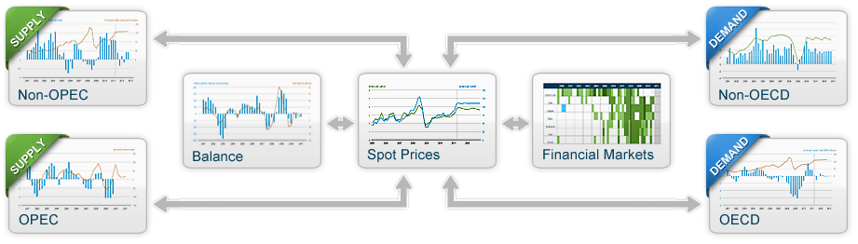
What factors can affect rig count?
https://www.eia.gov/finance/markets/crudeoil/
Notes:
So what other factors can influence rig count?
According to the EIA there are a number of factors that influence the price of oil – mainly split between supply (OPEC and non-OPEC production) and demand (consumption). There are a lot of sub factors at play here that could also influence the US rig count. We’ll need to find a few to build a model that will appropriately predict rig count in the US.

Slide 8
Data wrangling and analysis

Slide 9
What data will be used?
Rig count data
Economic data
From Baker Hughes Rig Count (rigcount.bakerhughes.com)
From 2011 – present (weekly)
From the US Energy Intelligence Agency (eia.gov)
Oil prices (WTI, Brent)
USA Production, Storage
OPEC / Non-OPEC production
OECD / Non-OECD consumption
Frequency varies (daily, weekly, monthly)
Overall data
510 observations
35 features
Notes:
What data will we use? The two subsets of data are the actual rig count data and the economic data.
The Rig Count Data comes from Baker Hughes – which has long been the standard for recording rig count data worldwide, and in the US. The data is available from 2011 to present and is available every week.
The economic data comes from the US Energy Intelligence Agency or EIA. Here we will have four subsets of data : oil price, USA storage and production data, OPEC and non-OPEC production data, and OECD and non-OECD consumption data. The frequency of this data varies from daily to monthly and have all been normalized to match the weekly rig count data.
Overall the data has 35 features and 510 observations.

Slide 10
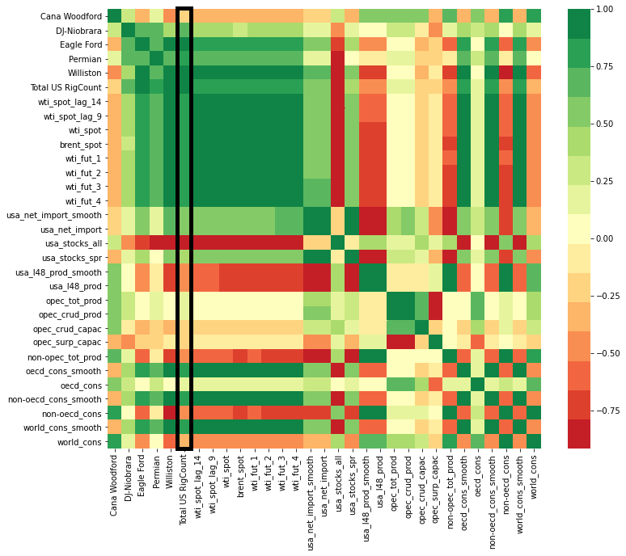
How do the data relate to rig count?
Rig Count
Oil Price
USA Oil Data
OPEC Production Data
World Consumption
Notes:
So how does it all relate to each other?
The rig data has been split up by basin here. For simplicities’ sake only the Total Rig Count will be assessed here. It is shown by the vertical black box.
The oil price data is highly correlated to each other, but is also highly correlated to the Total Rig Count, which is as expected.
The USA oil data shows both significant negative and positive correlations to the rig count.
OPEC production data shows less significant negative and positive correlations compared to the USA oil data but could still play a factor.
The world consumption data also shows a variety of negative and positive correlations. We’ll explore those in the next few slides.

Slide 11
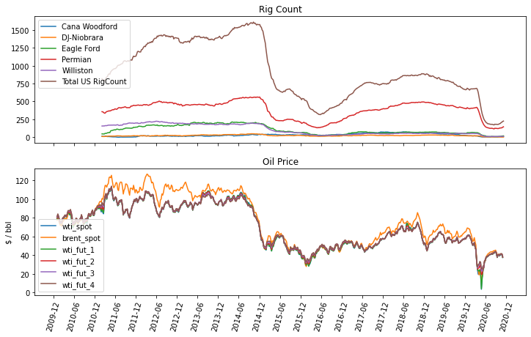
OIL PRICE
Notes:
The rig count is shown above, and oil price in the second graph. As mentioned before, we will only be considering the total rig count.
In terms of oil price, you can see many are show high collinearity and would hurt the model performance if all were included. As such only WTI (the standard for US oil prices) has been used.

Slide 12
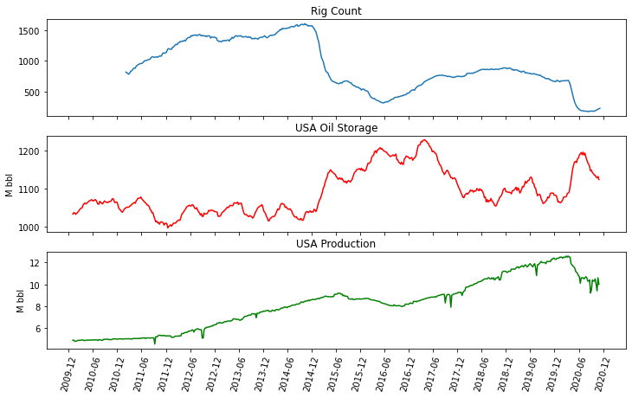
US OIL DATA
Notes:
Looking at the US oil data, we have production and storage graphed with rig count here.
The amount of stored oil increases when rig count (and thus prices) are lower, and then the stocks are slowly reduced when the rig count starts to recover.
Rig count and production are not linear. This is because of a number of reasons, including efficiency of operations, and the fact that drilling isn’t necessarily tied to production. You could drill wells without producing from them. This is called a “DUC” or drilled uncompleted well.

Slide 13
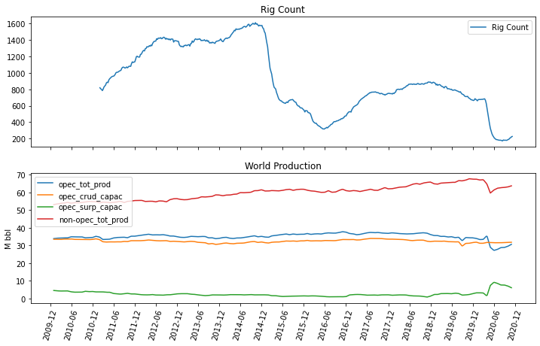
OPEC production
Notes:
OPEC and non-OPEC production tend to be quite flat over the course of the past 10 years, however their importance in modelling shows near the end of the timeline.
As prices plummeted, OPEC decided to cut their production artificially to try to stable the prices. This is shown in the opec surplus capacity line in green (how much they are holding back). As the price begins to recover, they increased their production (reducing surplus capacity).

Slide 14
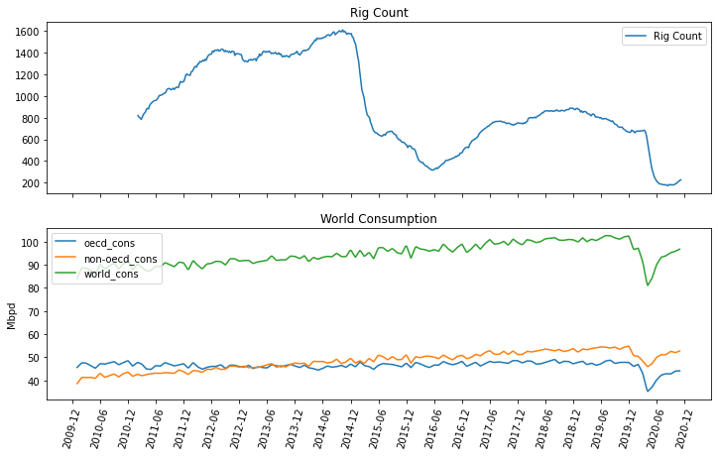
World consumption
Notes:
Similar to the OPEC production data, the consumption data seems quite flat until 2020 when COVID-19 hit. This is more correlated with the price crash and subsequent recovery.

Slide 15
Model training and performance

Slide 16
model objective
Predict percent change in US oil rig count 8 weeks into the future
Chose classification over multivariate time series due to:
Predictions will be binned into four different categories :
Reduced complexity
Increased model accuracy
Decreased computation time
Significant decrease ( - - )
Slight decrease ( - )
Slight increase ( - )
Significant increase ( + + )
Notes:
So what is the objective of this model?
The objective is to predict the percent change in US oil rig count 8 weeks into the future.
I chose to do a classification model over a multi variate time series model due to the reduced complexity, increased model accuracy, and decreased computation time.
We’ll turn this into a classification problem by “binning” predictions into four different categories, a significant decrease or increase, and a slight decrease or increase.

Slide 17
Modelling OVERVIEW
Encoding classification labels
Data split into train and test set
33% test set
Model training
Grid Search for parameter optimization
5-fold cross validation
Model evaluation, selection, and performance
Multivariate classification scoring metrics
Notes:
The steps that we’ll go through in this section will be to encode the classification labels into the data.
Split the data into train and test set (here the test set will consist of 33% of the data).
Model training, using grid search for parameter optimization and 5 fold cross validation
And finally model evaluation, selection and performance investigation. Here we will use multiple classification scoring metrics to choose which model is best.

Slide 18
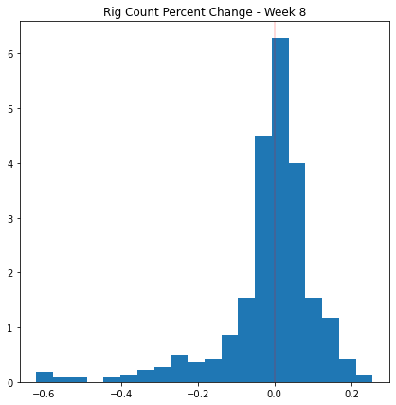
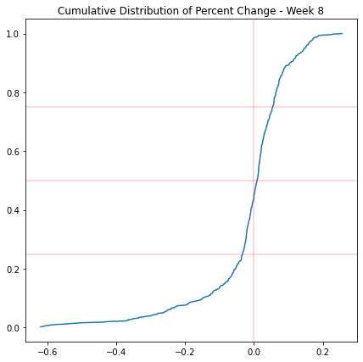
Classification categories
( + + )
( + )
( - )
( - - )
Notes:
To encode the classification categories, the percent change was found between the date t, and t + 8. These values were calculated and plotted in a histogram and cumulative distribution graph. The distribution is close to normal with a long left tail.
I decided to split the data into four bins, divided between positive and negative changes.

Slide 19
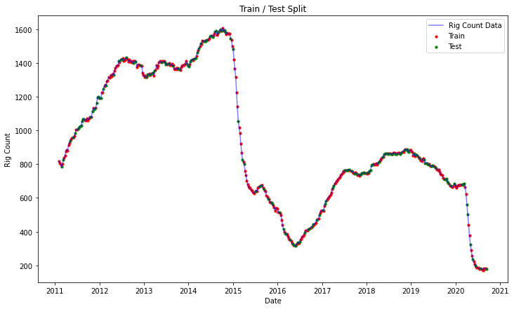
Data split
Notes:
The data was split as mentioned before with a 66% train, and 33% test split. The distribution of the split can be shown here. This split was kept consistent during the training and evaluation of the model.

Slide 20

Model training
Establish baseline :
Dummy Classifier
Random Choice
Models used :
Kmeans Clustering
Random Forest Classifier
XGBoost
Notes:
The model training procedure was to first establish a baseline using sklearn’s dummy classifier, and random choice (25% for each class, and 50% between positive and negative).
Then I used three different models to predict the rig count, Kmeans clustering as a measure of how physically close the data sets are, Random Forest Classifier, and XGBoost.

Slide 21
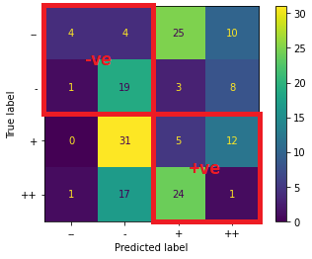
Model evaluation
Multivariate classification scoring metrics :
Accuracy
Precision
Recall
Positive / Negative Classification
Notes:
The models were evaluated using multiple classification scoring metrics for multivariate datasets. Accuracy, precision and recall are standard scoring metrics. Average scores will be shown, however, the individual performance of all metrics were used during the optimization of the model.
The positive negative classification is shown in the confusion matrix on the right. The objective of the positive negative classification is to define how many points were predicted as positive, but were actually negative, and vice versa. This is the most important metric of them all, as the value of the model is completely lost if the model misclassifies a positive as a negative.

Slide 22
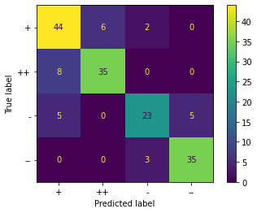
Model selection
 | Accuracy | Avg Precision | Avg Recall | Pos Neg Class
RFC – Pos / Neg | 83% | 83% | 83% | 96%
RFC – Neg Recall | 79% | 79% | 79% | 93%
XGB – Base | 77% | 77% | 77% | 93%
XGB – Neg Recall | 75% | 75% | 75% | 93%
RFC – Base | 78% | 78% | 78% | 92%
XGB – Pos / Neg | 76% | 76% | 76% | 91%
Dummy – Baseline | 28% | 28% | 28% | 55%
KMeans – k = 4 | 32% | 33% | 32% | 49%
Notes:
Here is a table of all the models that were trained. The baseline dummy classifier performs slightly better than random choice, while Kmeans performs worse than the dummy classifier. This shows that the data are not grouped and requires a more complex analysis.
The Random Forest Classifiers and XGBoosts were optimized with different metrics, as well as their base model performance. The Random Forest Classifier using the positive negative classification metric to during parameter tuning provided the best performance.
The confusion matrix is shown on the right.

Slide 23
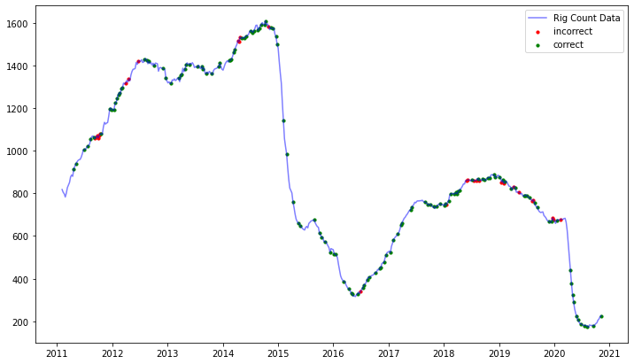
Model performance
No obvious trend of misclassifications
7 pos / neg misclasses
No severe misclasses (from ‘++’ to ‘-’ or ‘–’)
Perfect performance for test data since the COVID-19 crash
Notes:
As apparent in the table on the previous slide, the model performed very well. The performance of the test points are shown on the graph on the right. The correctly predicted points are coloured in green, while the incorrectly predicted points are coloured in red.
There are no obvious trends in misclassifications. Most misclassifications were between positive and positives or negatives and negatives. And were scattered throughout the timeline.
Only seven points were misclassified between positive and negative. Most of these points were along the border of the bins.
No severe misclasses were apparent (predicted a significant increase, when the actual data was a significant decrease).
In addition, and most importantly the model performed perfectly since COVID-19 crash, despite the significant fluctuations involved.

Slide 24
FUTURE IMPROVEMENTS

Slide 25
FUTURE IMPROVEMENTS
Increase the amount of bins
Significant decrease / increase is a large range
Predict rig count of individual basins
Requires additional data / features
Adds more specific value to regional stakeholders
Revisit regression prediction model
Adds easier visualization of the project
Specific rig count adds confidence in model
Visual or interactive feature
Prediction calculator or dashboard
Would allow stakeholders to use model without running code
Notes:
So what could be improved on this model?
Most important thing to improve would be to increase the number of bins. The significant increases and decreases encompass a large range. The more specific we can be the more value we can give to the stake holders.
I’d also like to predict the rig count in individual basins. However this requires additional data and features. Specifically I’m looking for break even prices for operators in a specific location, which I was unable to find public data for. This would help add further value to regional stakeholders.
I’m looking to revisit the regression prediction model, preferably employing some more advanced models to increase the accuracy in performance. Having a specific rig count number would help improve the confidence in the overall model as opposted to having a percentile range.
And finally I’m looking to add an interactive feature to the model. This could range from a prediction calculator (insert data here and output the expected change 8 weeks down the line), or a dashboard with a more visual interface. This would also help more stakeholders be able to interact with the model without having to load and run specific code.

Slide 26
Thank you for listening

